Slide 1


shodwe
HoteL
Group 4
HOSPITALITY ANALYTICS

Slide 2

5) Vikrant banode 6) Santosh abithan 7) swagatika satpathy
Team Members
1) Adyasa Priyadarsini Acharya 2) Snehlata Choubey 3) Makala Deepak 4) Saurabh Jondhale

Slide 3

Hospitality analytics
modules
excel
sql
Power bi
tablue

Slide 4

OverView
Hospitality Analytics helps hotels analyze bookings, revenue,
occupancy, and cancellations. The project uses SQL to extract
KPIs like
total revenue, occupancy rate, and cancellation trends . Excel dashboards provide pivot-based visualizations
for quick performance tracking. Tableau dashboards deliver Interactive insights with city-wise, category-wise, and time-based analysis.
Power BI dashboards allow real-time monitoring with dynamic filters and drill downs. Overall, the project supports data-driven decision-making to boost efficiency and maximize revenue.

Slide 5
Kpi’s
Total Revenue
Occupancy Rate
Cancellation Rate
Total Bookings
Utilized Capacity
Trend Analysis
Weekday & Weekend Revenue and Booking
Revenue by State & Hotel
Class Wise Revenue
Checked Out / Cancel / No Show
Weekly Trend – Key Metrics

Slide 6
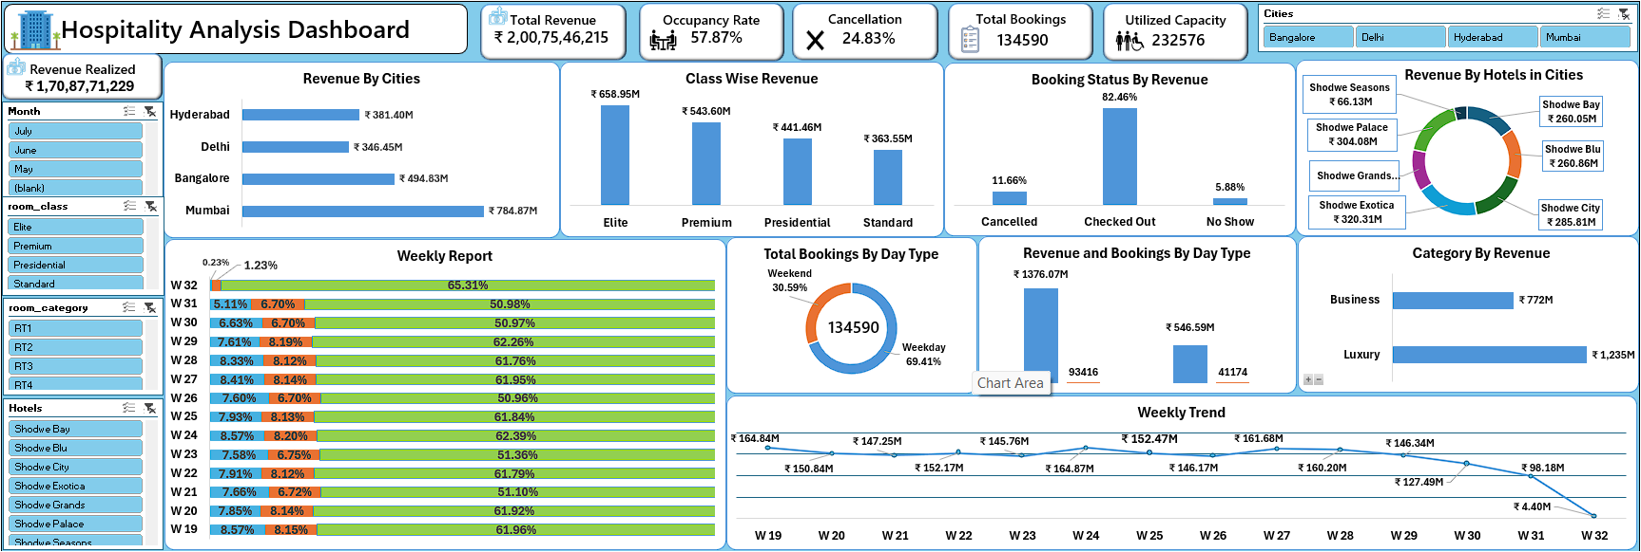
Excel dashboard
About dashboard
This dashboard provides a comprehensive
overview of the hospitality business performance,
highlighting key metrics across cities, room
categories, revenue classes, and booking trends.
Key Metrics
Total Revenue: ₹200.75 Cr
Revenue Realized: ₹170.87 Cr
Total Bookings: 1,34,590
Utilized Capacity: 2,32,576
Occupancy Rate: 57.87%
Cancellation Rate: 24.83%
Insights
City-Wise Revenue Performance
Mumbai: ₹784.87M (Highest)
Followed by Bangalore, Hyderabad, and Delhi.
Top Performing Hotels
Shodwe Bay: ₹260.65M
Shodwe Seasons: ₹66.13M
Shodwe Exotica: ₹320.31M
Contribution from 6 hotels is visualized via a donut
chart.

Slide 7
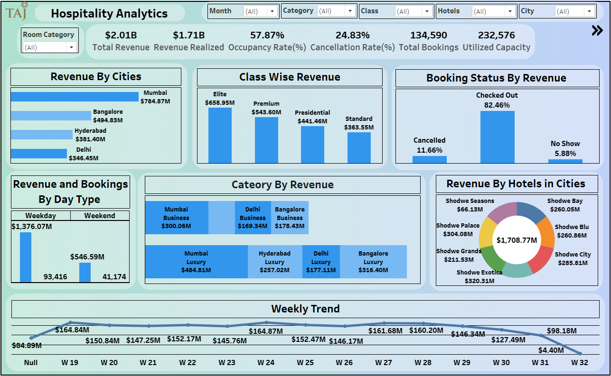
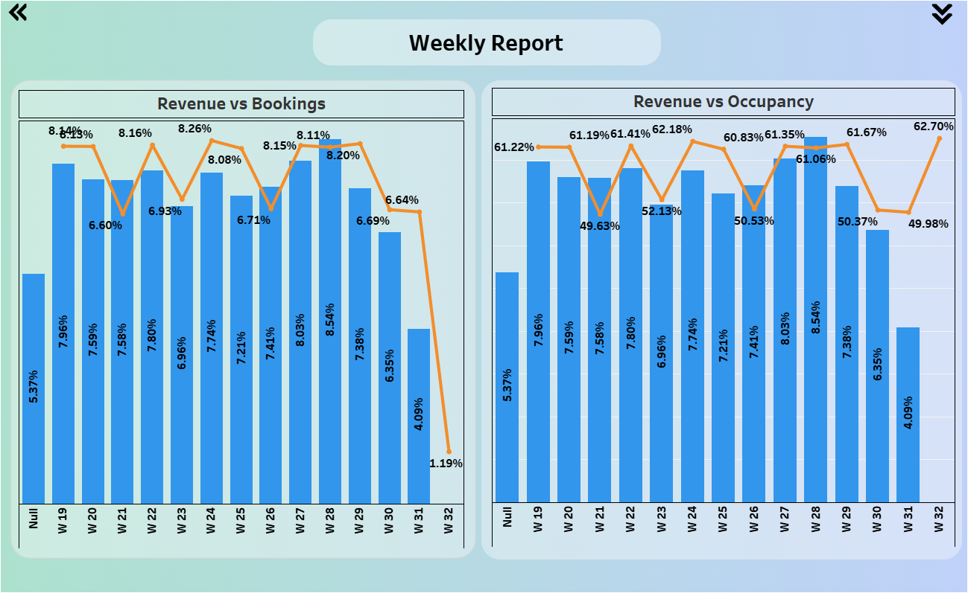
Tableau dashboard
About dashboard
This dashboard presents a detailed view of hotel revenue
performance and booking patterns across multiple cities an
categories.
Key Metrics
Total Revenue: ₹2.01B Revenue Realized: ₹1.71B
Occupancy Rate: 57.87% Cancellation Rate: 24.83%
Total Bookings: 134,590 Utilized Capacity: 232,576
Insights
Top City: Mumbai leads with ₹784.87M revenue
Top Class: Elite rooms generate the highest revenue (₹658.59M)
Booking Behavior: 82.46% of guests checked out successfully, with
minimal no-shows
Revenue by Day Type: Weekdays dominate with ₹1.37B
compared to ₹546.59M on weekends
Category Trends:
Luxury Segment: Highest in Mumbai (₹484.81M)
Business Segment: Strong in Mumbai (₹300.06M) and
Bangalore (₹178.43M)
Hotel Performance: Shodwe Exotica (₹320.31M) and Shodwe
Palace (₹304.08M) lead revenue generation
Weekly Trend: Stable weekly performance with peaks around
Week 26–28

Slide 8
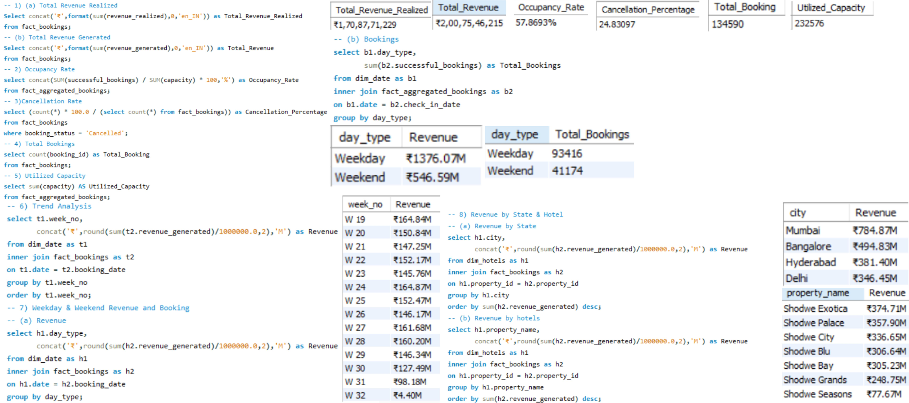
My SQL
About KPI’S
1. Total Revenue Realized: ₹1,70,87,71,229 → Actual income from completed bookings.
2. Occupancy Rate: 57.86% → Percentage of rooms occupied.
3. Cancellation Rate: 24.83% → Share of bookings that were cancelled.
4. Total Revenue Generated: ₹2,00,75,46,215 → Total potential revenue from all bookings.
Straight
Total Revenue Realized: ₹1,70,87,71,229 – This represents the actual income earned from all successfully completed bookings, showing the true revenue realized by the hotel.
Occupancy Rate: 57.86% – This indicates the percentage of rooms occupied compared to total available capacity, reflecting how efficiently the hotel utilizes its rooms.
Cancellation Rate: 24.83% – This shows the proportion of bookings that were cancelled, helping assess customer behavior and the impact of cancellations on overall performance.
Total Revenue Generated: ₹2,00,75,46,215 – This includes all revenue from both completed and pending bookings, highlighting the hotel’s total potential income

Slide 9
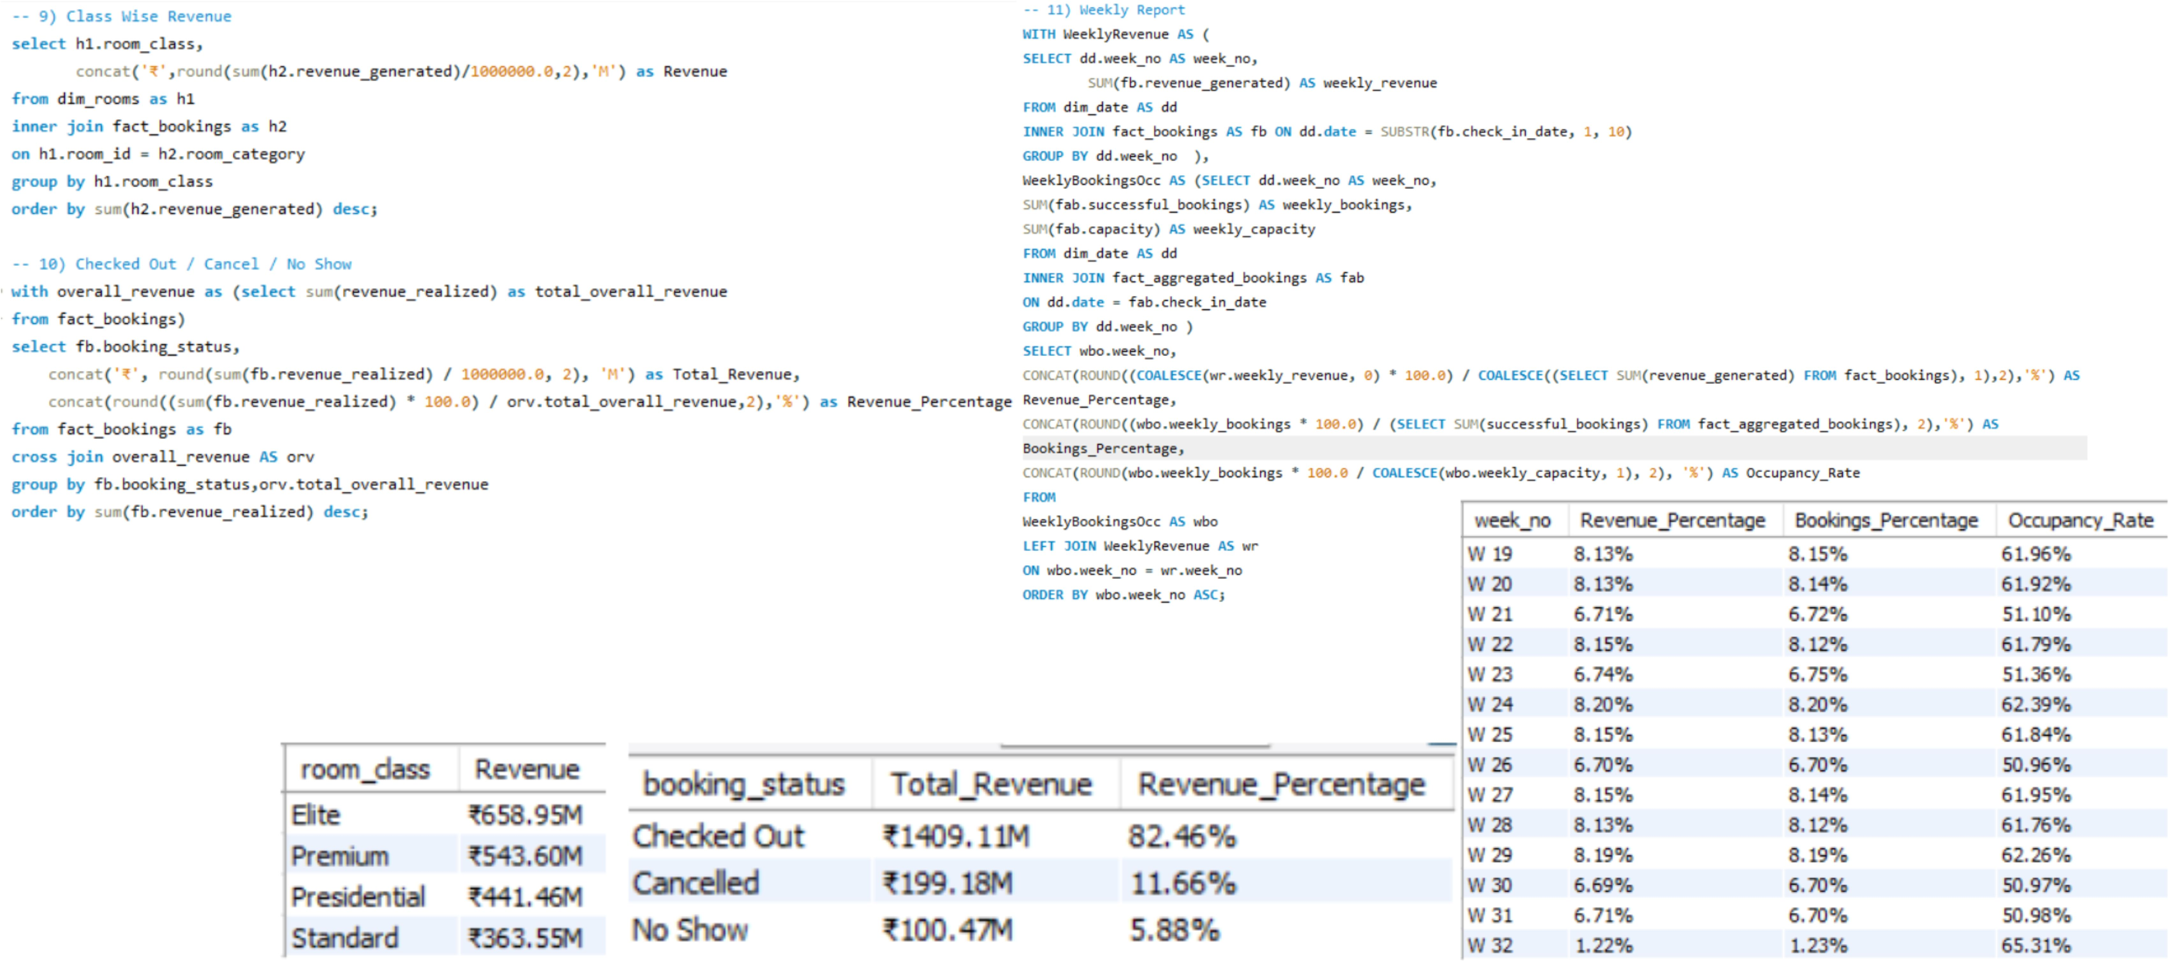
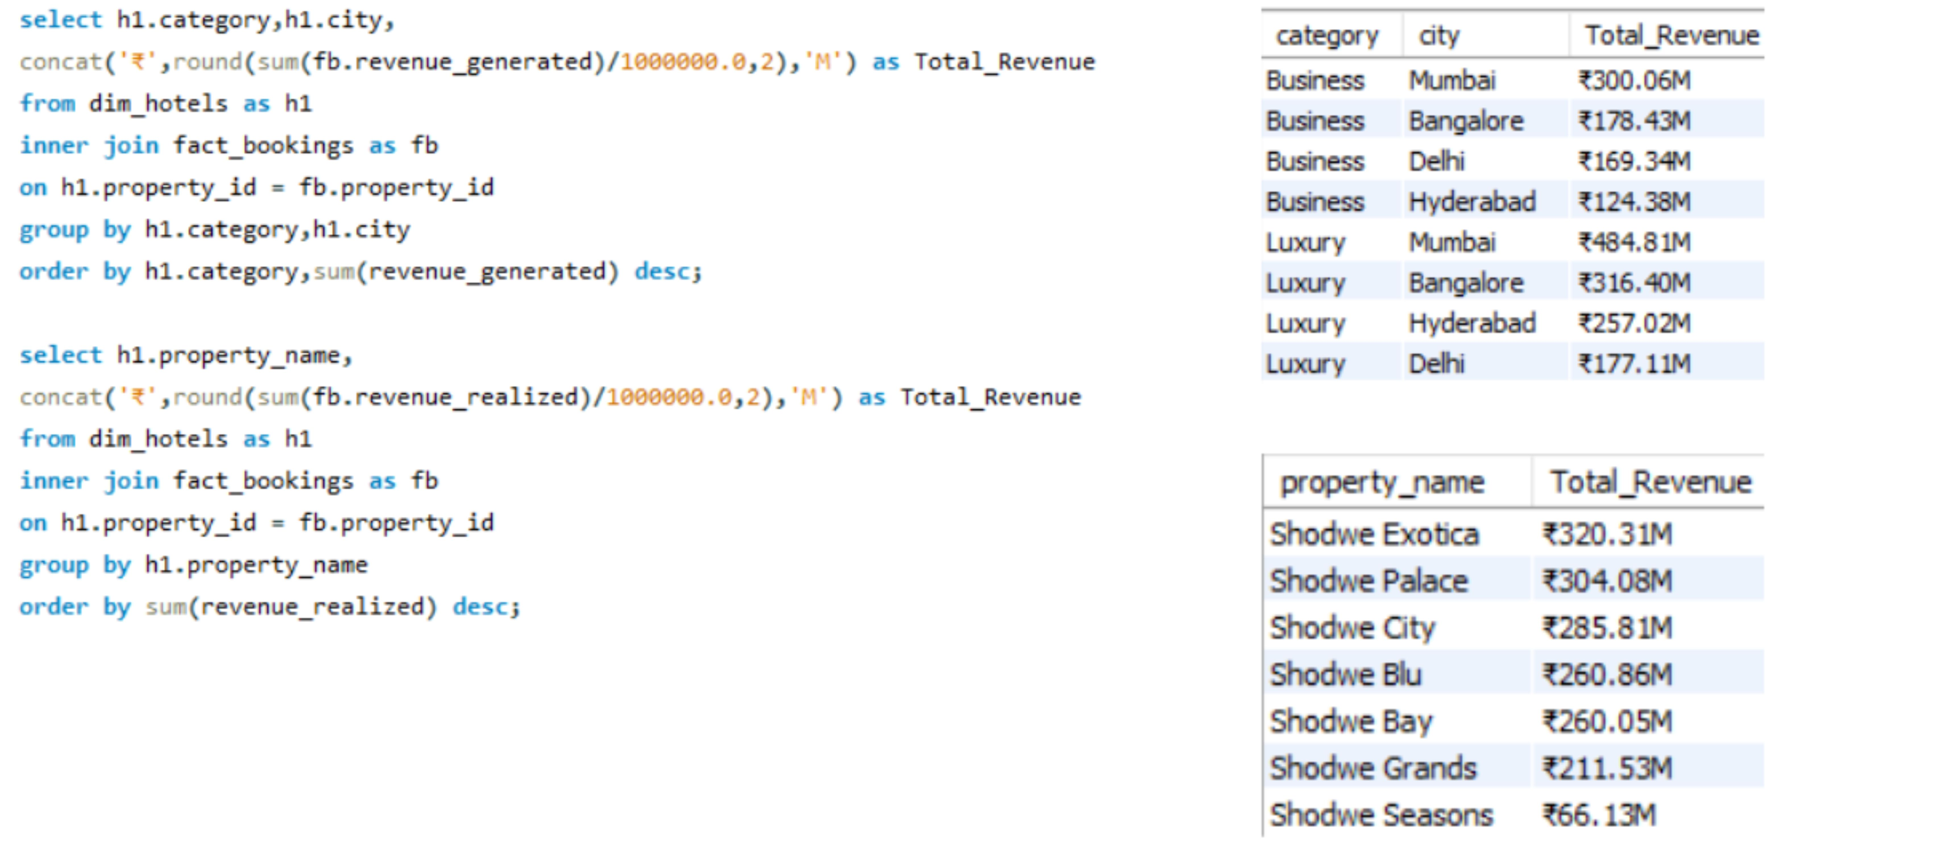
My SQL

Slide 10
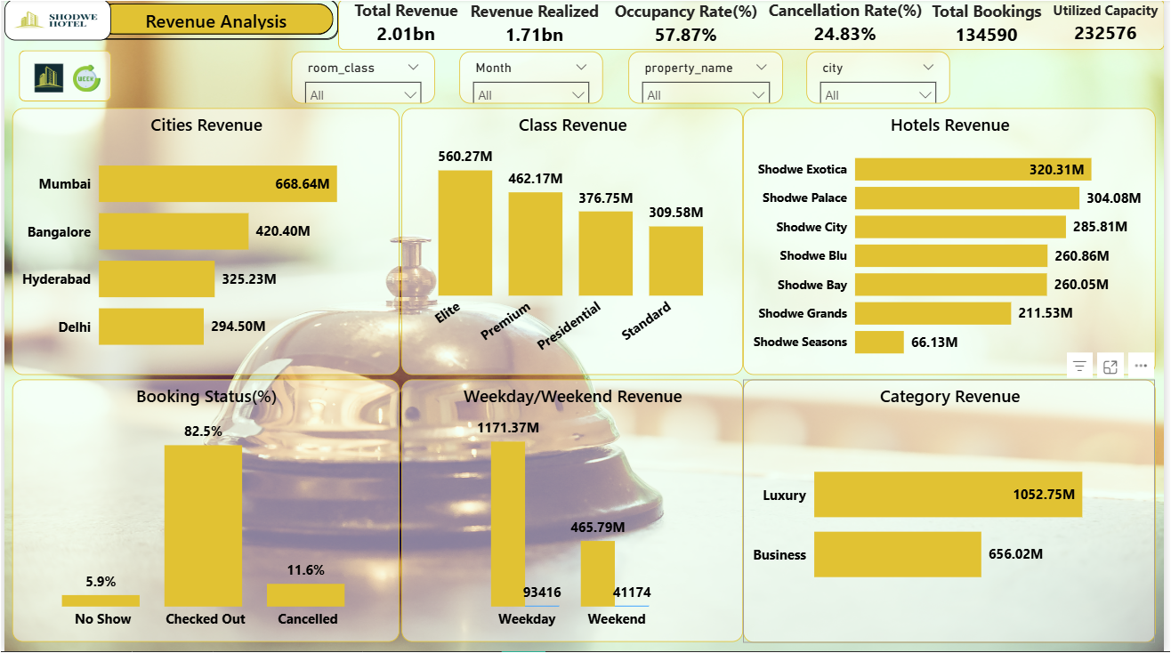
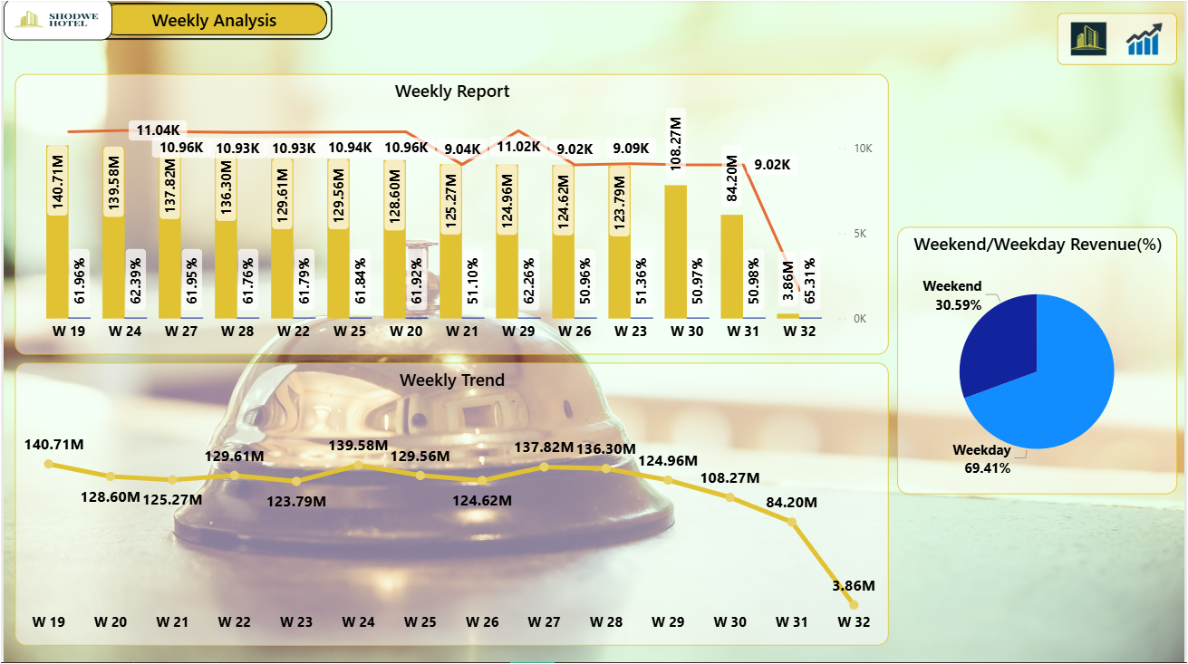
Power bi dashboard
About dashboard
This dashboard provides a comprehensive analysis of hotel performance metrics across multiple cities and properties.
Key highlights include:
Total Revenue: ₹2.01B with
Revenue Realized of ₹1.71B
Occupancy Rate: 57.87%
Cancellation Rate: 24.83%
Total Bookings: 134,590
Utilized Capacity: 232,576
Insights:
Top Performing City: Mumbai (₹668.64M revenue)
Highest Revenue Class: Elite (₹560.27M)
Leading Hotel: Shodwe Exotica (₹320.31M)
Category Trend: Luxury segment dominates with ₹1052.75M
Customer Behavior: 82.5% of bookings checked out successfully
Revenue Pattern: Weekday bookings (₹1171.37M) outperform weekends

Slide 11
Key takeaways
Data-Driven Insights: Hospitality analytics helps track and improve hotel performance through data from Excel,
SQL, Power BI, and Tableau.
Revenue Optimization: Achieved ₹1.70B realized revenue with potential of ₹2.00B total revenue.
Operational Efficiency: Occupancy Rate of 57.86% shows moderate utilization; opportunities exist to boost
booking conversion.
Customer Behavior: 24.83% cancellation rate highlights the need for better booking policies and retention
strategies.
Top Performers: Mumbai and Shodwe Exotica lead in revenue generation and occupancy.
Strategic Value: Interactive dashboards enable faster decision-making, improving profitability and resource
use.

Slide 12
recommendations
Enhance Customer Service:
Implement Al-driven chatbots for 24/7 customer support.
Train staff on customer engagement and conflict resolution.
Market Analysis and Adaptation:
Conduct market research to identify customer needs and preferences.
Adjust strategies based on competitive analysis and market trends.
Increase Sales and Retention:
Launch personalized marketing campaigns based on customer data.
Introduce loyalty programs to reward long-term customers.
Increase sales Delhi compared to all other cities, for increase sales focus on Business Category.
Employee Engagement:
Create a positive work environment to boost employee ability to work more.
Introduce employee recognition programs to retain top talent.

Slide 13
conclusion
Shodwe Hotel – Hospitality Analytics, demonstrates how data can transform decision-making in
the hotel industry.
By integrating SQL, Excel, Power BI, and Tableau, we successfully analyzed bookings,
revenue, occupancy, and cancellations to uncover key business insights.
The results show that Mumbai and Shodwe Exotica are top performers, with a 57.86% occupancy rate and
₹1.70B realized revenue.
The analysis also highlights areas for improvement, such as reducing the 24.83% cancellation rate and
increasing room utilization.
Overall, our project proves that data-driven analytics not only helps track performance but also supports
smarter strategies to maximize profitability, enhance customer satisfaction, and improve operational efficiency

Slide 14

Thanks
Your Comfort, Our Pleasure.

